Slide 1

Group Project II: Regression Analysis and Business Insight Extraction with Publicly Accessible Airbnb Data
By Chandima Attanayake, Ryan Boyle, Evan Avelluto, Nicole Minor, Hannah Orazem (Group #3)
Notes:
This is the presentation for group # 3 and we decided to complete the second group project option regarding regression analysis and business insight extraction with publicly accessible Airbnb data for new York city.

Slide 2
Breakdown of Tasks
Data Preprocessing and Transformations: Chandima Attanayake
Data Analysis Part 1 (Bullet Points 1-3): Ryan Boyle
Data Analysis Part 2 (Bullet Points 4-6): Evan Avelluto
Compile Report and Analysis: Hannah Orazem
Create and Narrate Presentation and Submit: Nicole Minor
Notes:
Here is the breakdown of the tasks to complete this group project and who completed each step.

Slide 3
Key Findings
Top 5 Hosts with the most reviews
Busiest Host and Why
Average price of New York City Neighborhoods
Price differences between Manhattan and Brooklyn for similar listings
Price Based on Location
Price differences between shared and private rooms
Notes:
Here are the key findings that will be covered in this presentation.

Slide 4
Top 5 Hosts With The Most Reviews
Host Name | Neighborhood | Total # of Reviews
Maya | Queens | 227
Brooklyn& Breakfast -Len- | Brooklyn | 220
Danielle | Queens | 201
Yasu & Akiko | Manhattan | 197
Brady | Brooklyn | 181
Notes:
Here we can see the top five hosts with the most reviews. While these top five hosts have a lot of reviews it can be both a good or bad thing for the hosts depending on the content of the reviews. For instance, Maya has the most total reviews at 227, does this mean that Maya is the best host out of all the hosts in the data set? Not necessarily. If the majority of the reviews are negative, then Maya is going to have a harder time getting people to book at her Airbnbs. On the other hand, if Maya’s reviews are mostly positive then Maya is likely going to find her Airbnbs being booked more frequently.
However, there are many factors that go into reviews – did the consumer write a review unprompted? was the consumer asked to write a review? When a consumer leaves a review, it is often on a scale of 1-5 with 5 being the best and 1 being the worst – how individuals grade the review can vary even if they have a similar experience – one may leave a 5 star review while the other may leave a 3 star review saying it was an average experience.
Total number of reviews is important as it provides the consumer and host with more data points to pull from but the actual content of the reviews need to be taken into consideration when making Airbnb selections in New York City.

Slide 5
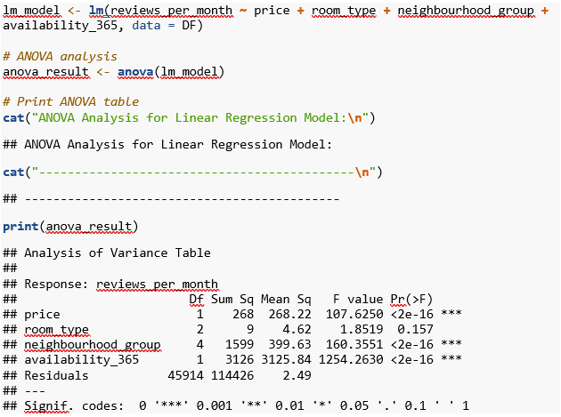
Busiest Hosts and Why?
Host Name | Average Reviews per Month
Louann | 20.9
Nalicia | 18.1
Brent | 15.8
Dona | 14.0
Row NYC | 14.0
Danielle | 13.6
Aisling | 13.4
Stephanie | 13.3
Malini | 13.2
Ben | 13.1
Notes:
When we look at the average number of reviews by month we end up with a different list of hosts. These ten hosts can be considered the busiest as One they are receiving reviews of their Airbnbs multiple times a week or on an almost daily basis like Louann who receives on average almost 21 reviews a month. Not only are these top ten host receiving a high number of reviews each month but based on the ANOVA analysis we can see that price, location, and availability are statistically significant based on the p-value to the number of average reviews per month for these hosts. This implies that these ten hosts have competitive value and services that consumers are willing to pay money for.

Slide 6
Average Price of New York City Neighborhoods
Manhattan - $146
Brooklyn - $106
Staten Island - $89.20
Queens - $88.90
Bronx - $77.40
Notes:
When it comes to average price of new York city neighborhoods, we can see that Manhattan is the most expensive at $146, then Brooklyn at $106, Staten Island at $89.20, Queens at $88.90 and the most inexpensive on average is the Bronx at $77.40.

Slide 7
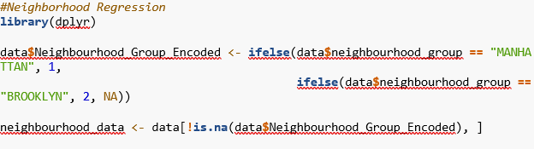
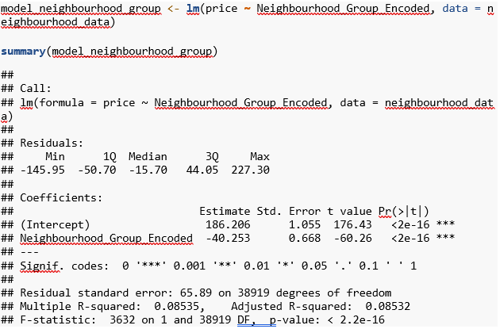
Price Differences Between Manhattan and Brooklyn for Similar Listings
Notes:
If we look at Manhattan and Brooklyn which on average are the two most expensive places to stay in an Airbnb in New York City, how much of a price difference is there for similar listings? On average staying at an Airbnb in Brooklyn is about $40.25 cheaper than the Airbnbs in Manhattan. One likely reason Brooklyn is less expensive than Manhattan is that Manhattan has many tourist attractions like Times Square. The next slide will provide a visual representation of this as well a visual representation of the average price of Airbnbs for all New York City neighborhoods.

Slide 8
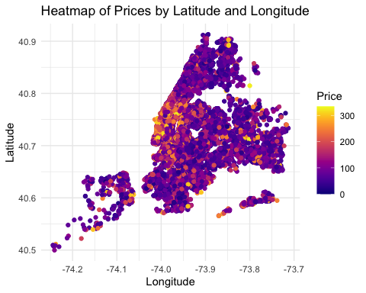
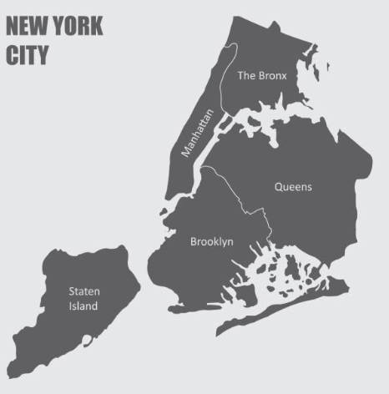
Price Based on Location
Luisrftc. “Map of New York City, with Borders of the Regions and Labels.” iStock, 8 Aug. 2019, www.istockphoto.com/vector/map-of-new-york-city-gm1166829871-321569879.
Notes:
Using a heatmap we can create a visual representation of the average price of an Airbnb based on location. Dark purple areas are the least expensive while orange and yellow areas are more expensive. The picture on the right is a map of new York city and because there are so many Airbnbs within new York city, the heatmap creates a close outline of the map on the right From the heatmap we can see that Manhattan generally has the most expensive Airbnbs which makes sense as Manhattan is home to many tourist attractions like the Statue of Liberty, Empire state Building, and Central Park. Depending on what one wants to do in new York city it may make more sense to stay in a Airbnb in Queens or Brooklyn where the cost of the Airbnb on average is cheaper and one is still centrally located to commute to different attractions.

Slide 9
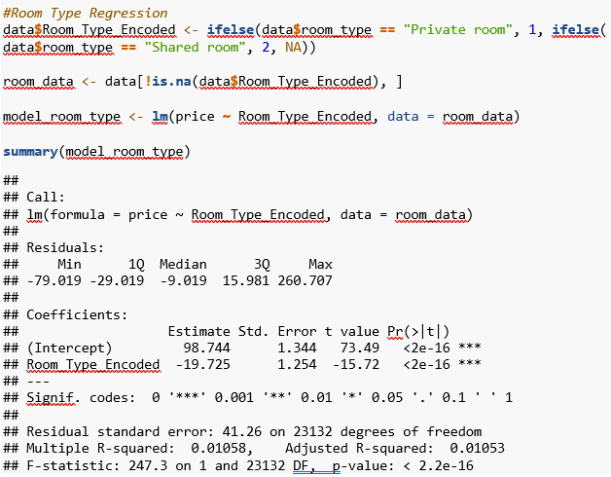
Price Differences Between Shared and Private Rooms
Notes:
Price of private rooms are on average about $19.73 cheaper than shared rooms. However, this data is skewed as there is about 23,000 data points for private room data whereas shared room data only has about 200 data points. This data skewness makes sense as generally speaking most people do not want to share rooms where they sleep and get ready in the morning with people they do not know. Another potential reason for the skewness in this data is that Airbnbs may not normally offer shared rooms.

